Slide 1
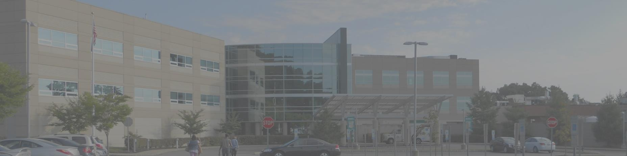
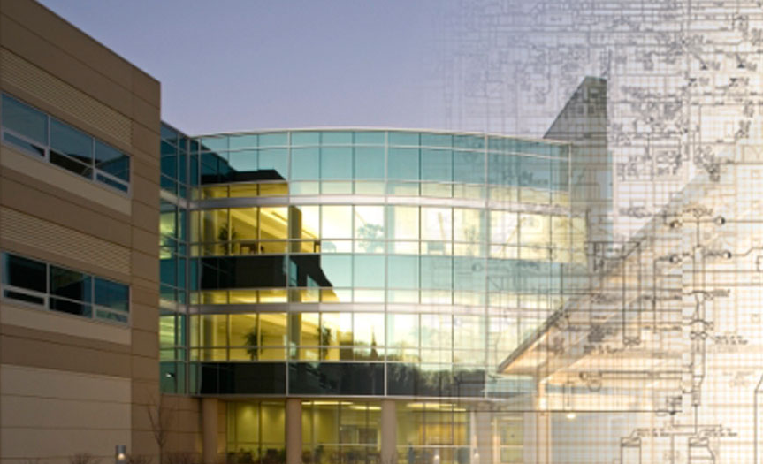
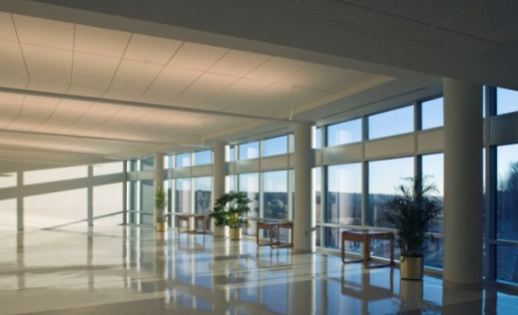
The State Institute of Rehabilitation
New Jersey
Elizabeth C. Krauss
Mechanical Option

Slide 2
The State Institute of Rehabilitation
Building Summary
Objectives
Mechanical Investigation
Electrical Investigation
Overall Evaluation
Conclusion

Slide 3
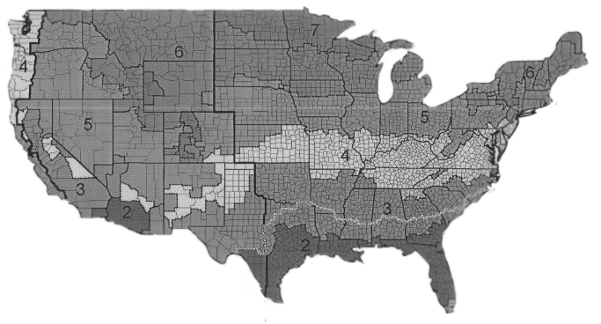
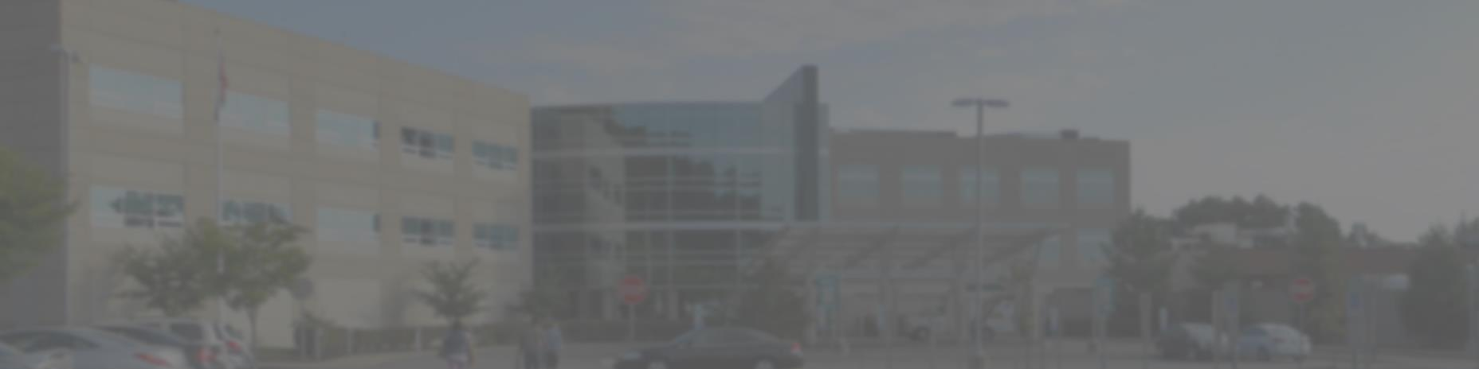
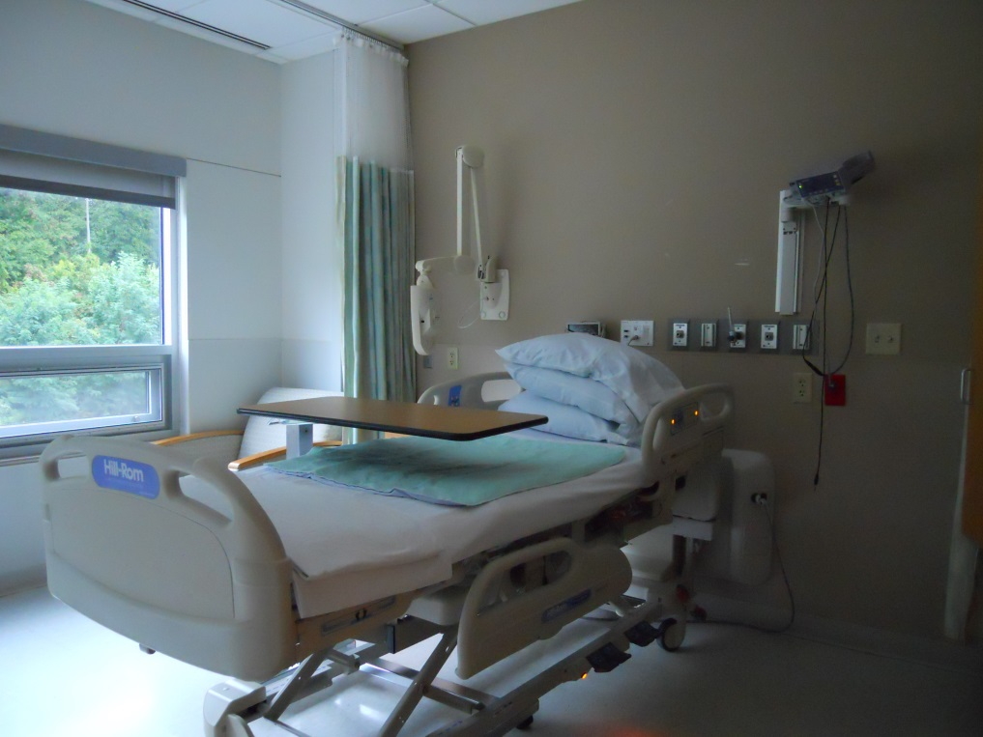
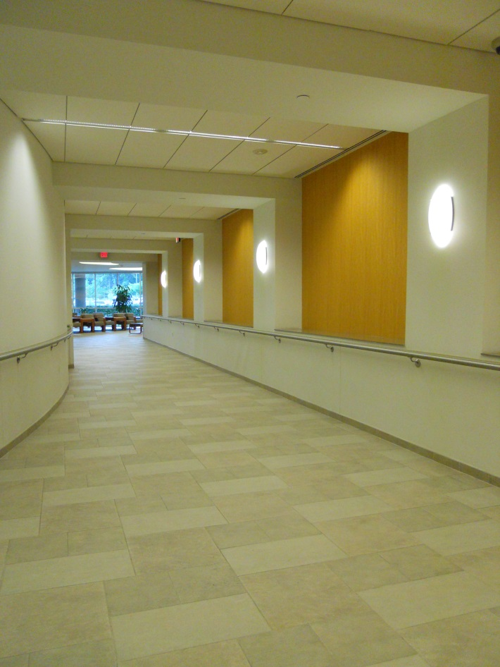

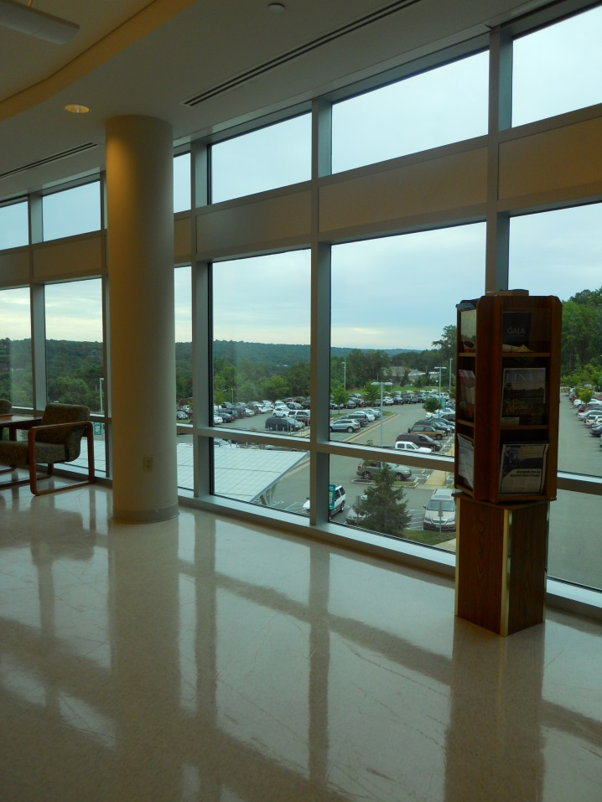
Building Summary
  Location and Occupancy
  Facility and Façade
  Equipment
    Existing Building
    Building Addition
  Electric Consumption
Objectives
Mechanical Investigation
Electrical Investigation
Overall Evaluation
Conclusion
  Location
  Occupancy
Outdoor Conditions
  Summer (0.4%):
    94ºF DB
    74.9ºF WB
  Winter (99.6%):
    11ºF DB
Indoor Conditions
  Summer:
    75ºF DB
    50% RH
  Winter:
    72ºF DB
    50% RH

Slide 4
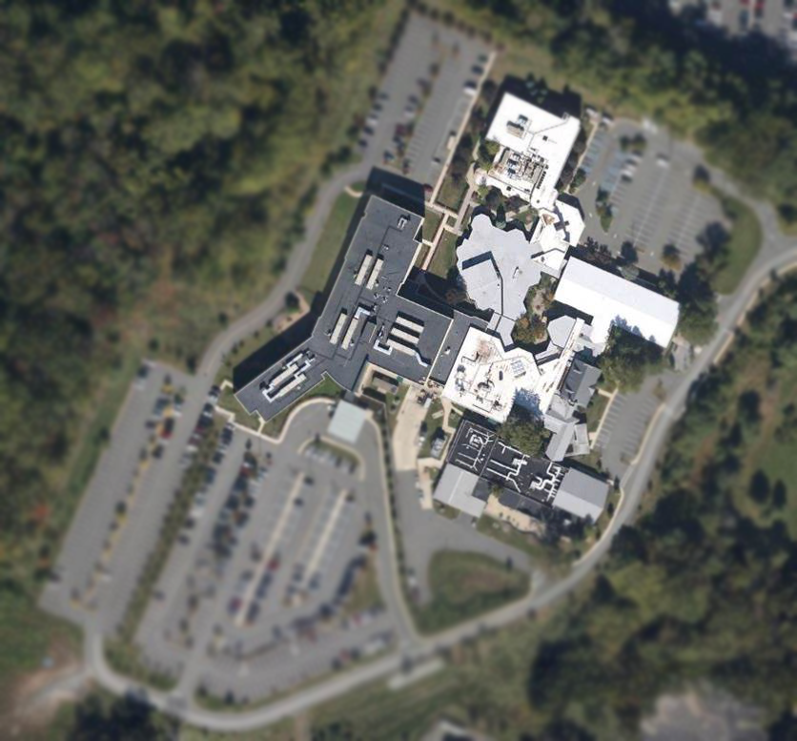
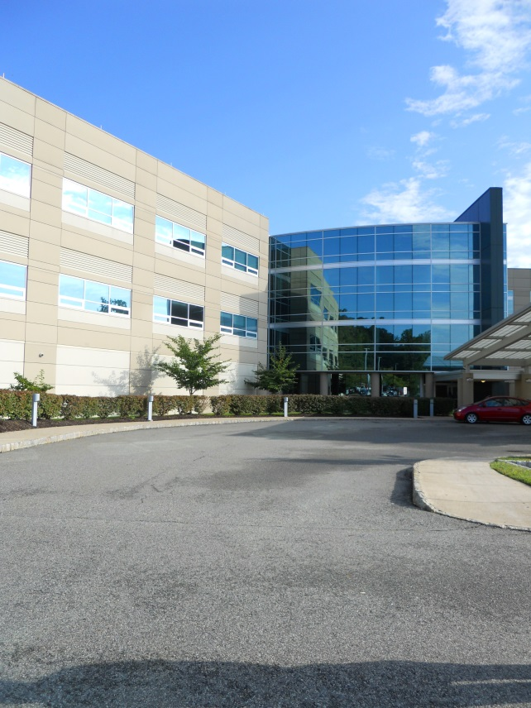
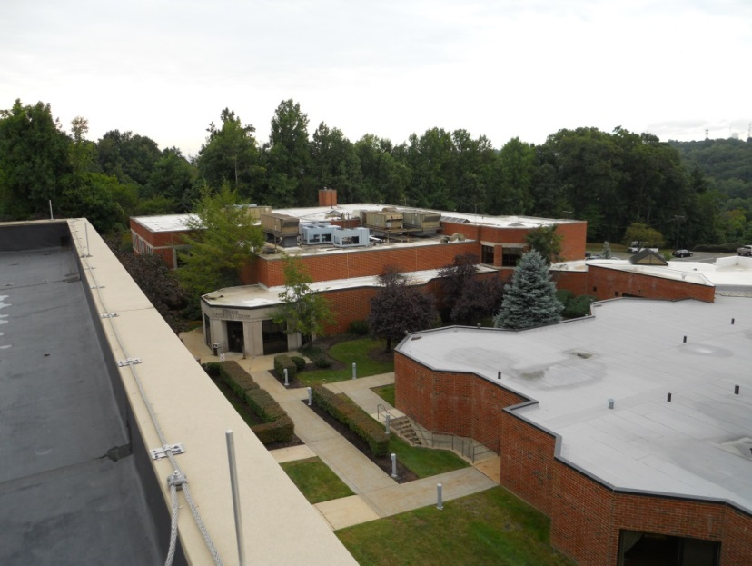


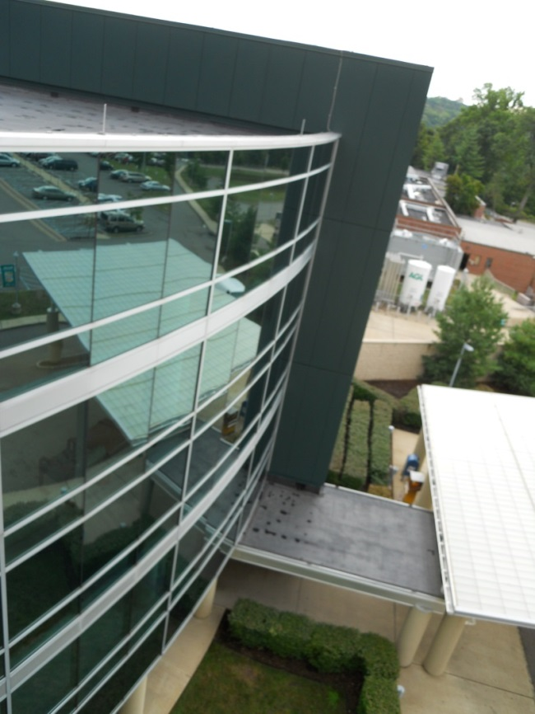
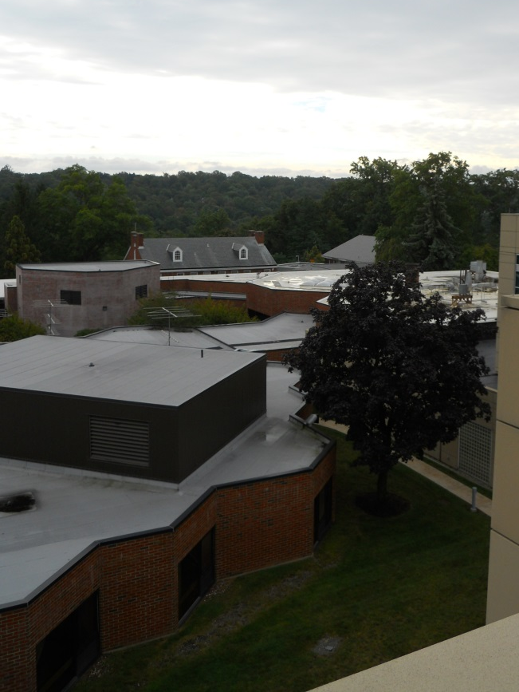
Building Summary
  Location and Occupancy
  Facility and Façade
  Equipment
    Existing Building
    Building Addition
  Electric Consumption
Objectives
Mechanical Investigation
Electrical Investigation
Overall Evaluation
Conclusion
  Facility
  Façade

Slide 5
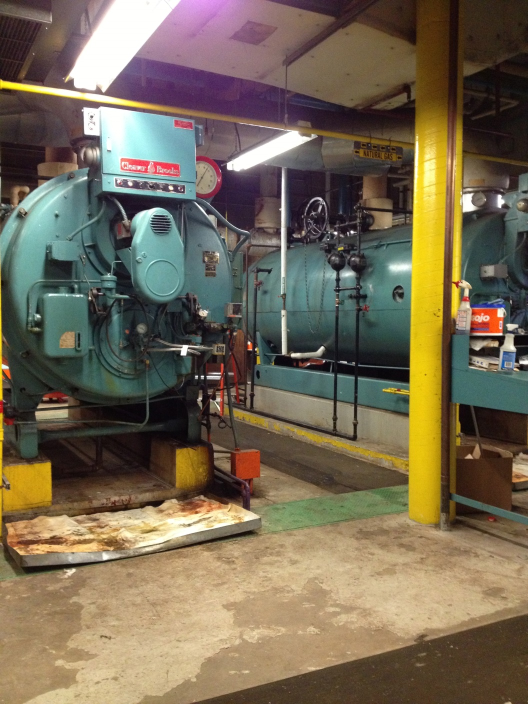
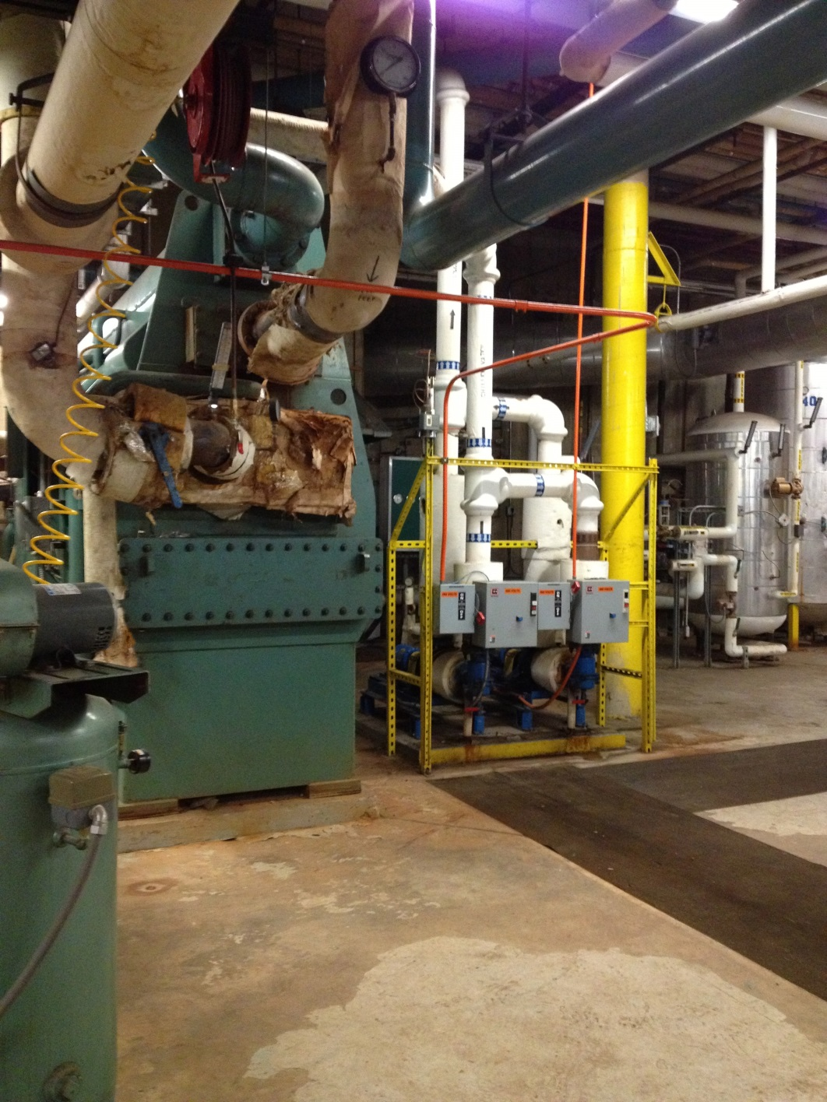


Building Summary
  Location and Occupancy
  Facility and Façade
  Equipment
    Existing Building
    Building Addition
  Electric Consumption
Objectives
Mechanical Investigation
Electrical Investigation
Overall Evaluation
Conclusion
  Heating
  Cooling
Boiler-1(1973):
Natural Gas
Output: 5021 MBH
Chiller-1(1973):
Electric Centrifugal
Output: 300 tons
Boiler-2(1973):
Natural Gas
Output: 5021 MBH
Chiller-2(1973):
Air Cooled Liquid
Output: 15.2 tons
Chiller-2(1973):
Air Cooled Liquid
Output: 18.4 tons
Decommissioned Chiller (1973):
Steam Absorption
Output: 230 tons

Slide 6
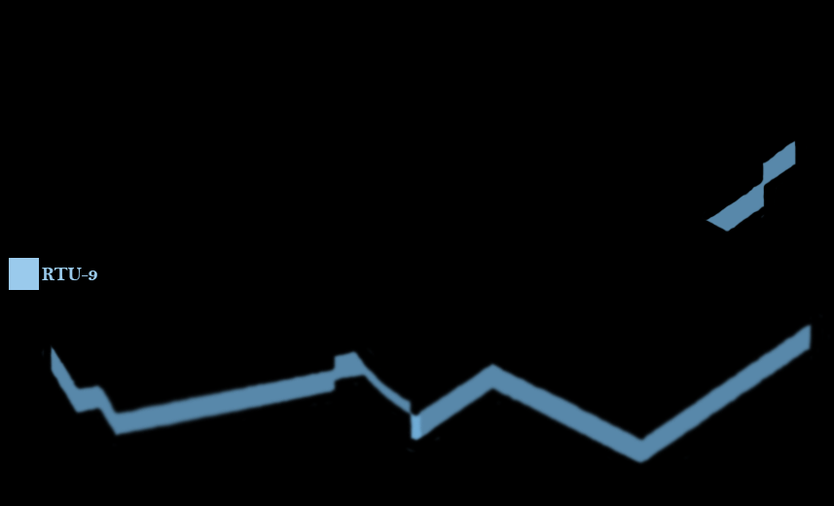


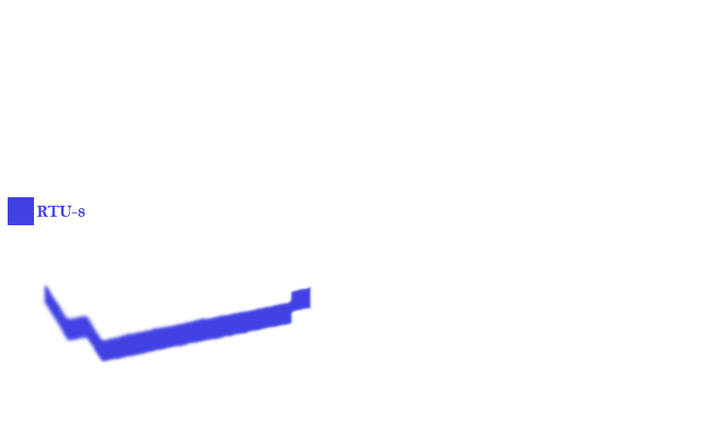


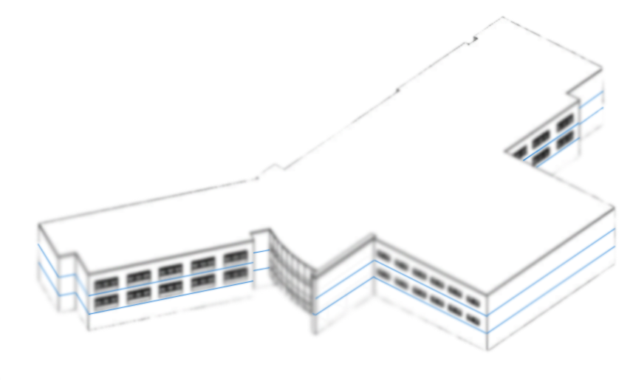



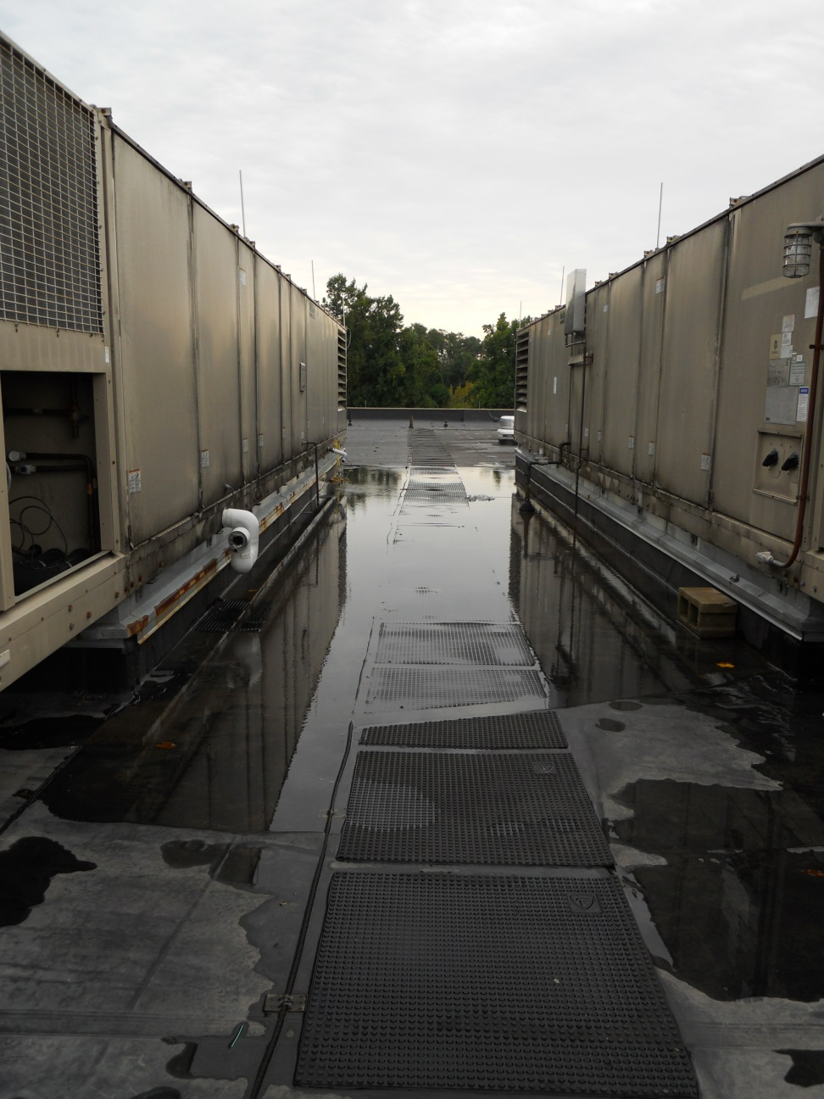

  Rooftop Units
  Capacities
Building Summary
  Location and Occupancy
  Facility and Façade
  Equipment
    Existing Building
    Building Addition
  Electric Consumption
Objectives
Mechanical Investigation
Electrical Investigation
Overall Evaluation
Conclusion
RTU-1
39 Tons cooling
470 MBH heating
11500 CFM
RTU-6
47 Tons cooling
570 MBH heating
14000 CFM
RTU-2
39 Tons cooling
470 MBH heating
11500 CFM
RTU-7
40 Tons cooling
510 MBH heating
12500 CFM
RTU-3
45 Tons cooling
470 MBH heating
12000 CFM
RTU-8
39 Tons cooling
510 MBH heating
12500 CFM
RTU-4
45 Tons cooling
470 MBH heating
12000 CFM
RTU-9
39 Tons cooling
476 MBH heating
12500 CFM
RTU-5
47 Tons cooling
570 MBH heating
14000 CFM
Total:
381 Tons cooling | 4516 MBH | 112,500 CFM

Slide 7
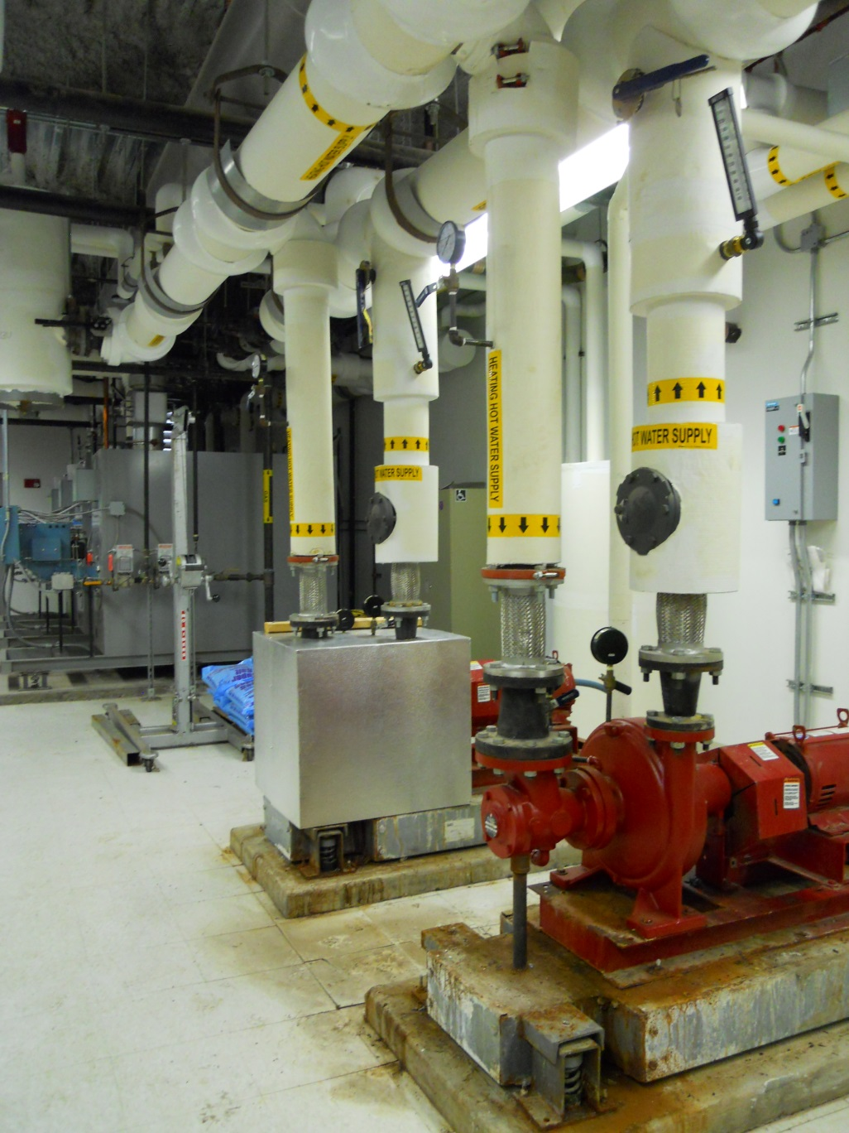
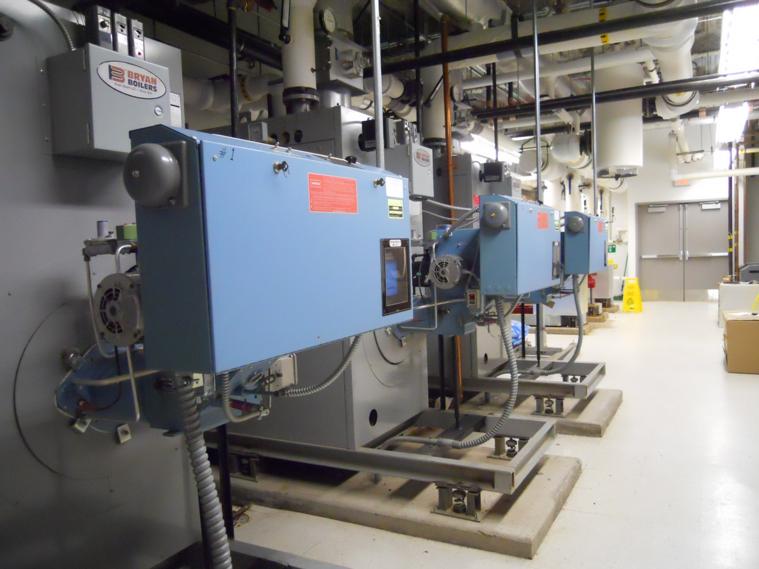
Building Summary
  Location and Occupancy
  Facility and Façade
  Equipment
    Existing Building
    Building Addition
  Electric Consumption
Objectives
Mechanical Investigation
Electrical Investigation
Overall Evaluation
Conclusion
  Heating
  Equipment
Boilers-1
Input: 2000 MBH
Output: 1600 MBH
8 Cabinet Unit Heaters
8 Unit Heaters
137 Variable Air Volume Units, hot water reheat
Boilers-2
Input: 2000 MBH
Output: 1600 MBH
Boilers-3
Input: 2000 MBH
Output: 1600 MBH

Slide 8
  Building Addition, Electricity
  Existing Building, Electricity
Building Summary
  Location and Occupancy
  Facility and Façade
  Equipment
    Existing Building
    Building Addition
  Electric Consumption
Objectives
Mechanical Investigation
Electrical Investigation
Overall Evaluation
Conclusion
=(2)*1890 MWh
= 3780 MWh
Total: 5,671 MWh
= 1890 MWh

Slide 9
  Operation Cost, Building Addition
  Operation Cost, Existing Building
Building Summary
  Location and Occupancy
  Facility and Façade
  Equipment
    Existing Building
    Building Addition
  Electric Consumption
Objectives
Mechanical Investigation
Electrical Investigation
Overall Evaluation
Conclusion
(134,861) + (120,226)
=$255,087
(269,772) + (240,452)
=$510,174

Slide 10
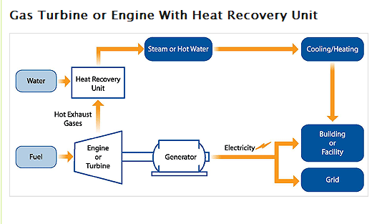
Building Summary
Objectives
Mechanical Investigation
Electrical Investigation
Overall Evaluation
Conclusion
  Objectives
  Plan
Upgrade
Combined Heat, Cooling, and Power
Increase
Source: United States Environmental Protection Agency (EPA)
Decrease

Slide 11
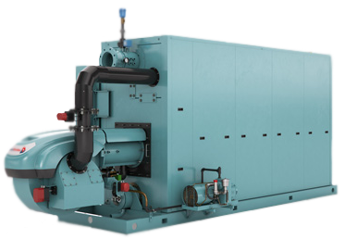
Building Summary
Objectives
Mechanical Investigation
  Equipment
    Boilers
    Combustion Turbine
    Chiller
    Air Distribution
  Operations and Cost
  Emissions
Electrical Investigation
Overall Evaluation
Conclusion
  Heating
  Boilers
Peak Demand Loads
(3) 6400 MBH Output
(3) 8000 MBH Input
Existing Building
2 * (5021 MBH)
= 10042 MBH
6,598 lbs./hr. steam ea.
Building Addition
4080 MBH
Total:
10042 MBH
+ 4080 MBH
14,122 MBH Demand
14,122 MBH ÷ (3 boilers) = 4703.3 MBH/boiler

Slide 12
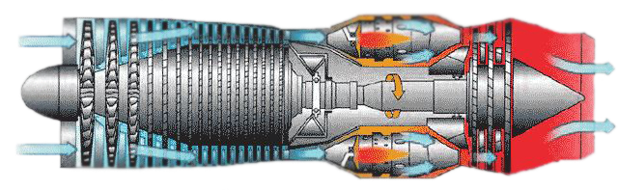
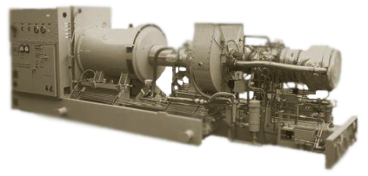
Building Summary
Objectives
Mechanical Investigation
  Equipment
    Boilers
    Combustion Turbine
    Chiller
    Air Distribution
  Operations and Cost
  Emissions
Electrical Investigation
Overall Evaluation
Conclusion
  Waste Heat
  Combustion Turbine

Slide 13
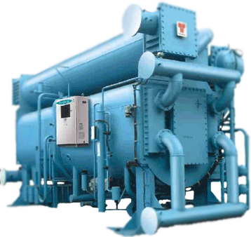
Building Summary
Objectives
Mechanical Investigation
  Equipment
    Boilers
    Combustion Turbine
    Chiller
    Air Distribution
  Operations and Cost
  Emissions
Electrical Investigation
Overall Evaluation
Conclusion
  Cooling Loads
  Double Effect Absorption Chiller
Peak Demand Loads
802 ton capacity
6873 lbs. steam/hr. consumption
Existing Building
300 tons
+ 18.4 tons
+ 15.2 tons
= 333.6 tons
Building Addition
448 tons
Total:
333.6 tons
+448.0 tons
781.6 ton Demand

Slide 14
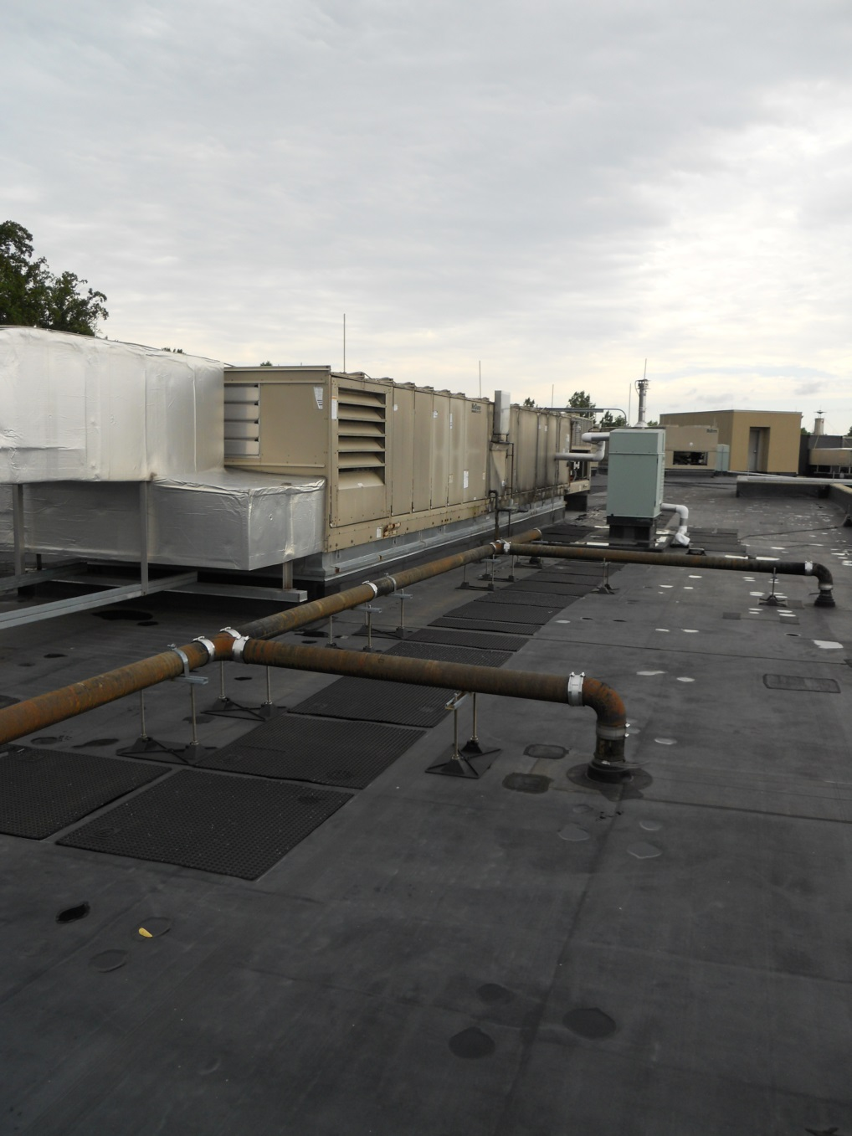

Building Summary
Objectives
Mechanical Investigation
  Equipment
    Boilers
    Combustion Turbine
    Chiller
    Air Distribution
  Operations and Cost
  Emissions
Electrical Investigation
Overall Evaluation
Conclusion
  Air Distribution, Addition
  Air Distribution, Existing
Cooling:
DX to Chilled Water
Heating:
Gas Burner to Steam
Cooling:
Chilled Water
Heating:
Steam

Slide 15
  Operation, Winter
  Operation, Summer
Building Summary
Objectives
Mechanical Investigation
  Equipment
    Boilers
    Combustion Turbine
    Chiller
    Air Distribution
  Operations and Cost
  Emissions
Electrical Investigation
Overall Evaluation
Conclusion
1.2 MW electricity
1.2 MW electricity
6745 MBH Waste Heat
6745 MBH Waste Heat
1255 MBH Nat. Gas
8000 MBH Nat. Gas
8000 MBH Nat. Gas
1255 MBH Nat. Gas
6400 MBH, 6598 lbs. steam
6400 MBH, 6598 lbs. steam
6400 MBH, 6598 lbs. steam
6598 lbs./hr. steam
802 tons cooling

Slide 16
Building Summary
Objectives
Mechanical Investigation
  Equipment
    Boilers
    Combustion Turbine
    Chiller
    Air Distribution
  Operations and Cost
  Emissions
Electrical Investigation
Overall Evaluation
Conclusion
  Building Addition, Demand
  Existing Building, Demand
Maximum Cooling Load: 2,978,380,800 BTU, July
Maximum Heating Load: 7,471,248,000 BTU, Jan.

Slide 17
Building Summary
Objectives
Mechanical Investigation
  Equipment
    Boilers
    Combustion Turbine
    Chiller
    Air Distribution
  Operations and Cost
  Emissions
Electrical Investigation
Overall Evaluation
Conclusion
  Annual Operating Cost
  Annual Operating Cost, Cooling

Slide 18
Building Summary
Objectives
Mechanical Investigation
  Equipment
    Boilers
    Combustion Turbine
    Chiller
    Air Distribution
  Operations and Cost
  Emissions
Electrical Investigation
Overall Evaluation
Conclusion
  Emissions, Before
  Emissions, After
Electricity
Electricity
0
Natural Gas
Natural Gas
Total
Total
29,211,537 lbs. CO₂ | 8,213 lbs. SO₂ | 44,912 lbs. NO
46,671,200 lbs. CO₂ | 4,112 lbs. SO₂ | 69,904 lbs. NO
37% increase CO₂ | 50% decrease lbs. SO₂ | 35% increase NO

Slide 19
Building Summary
Objectives
Mechanical Investigation
Electrical Investigation
  First Cost & Offset
  Cost of Operation & Grid Resale
Overall Evaluation
Conclusion
  First Cost, System
  Incentives
Electricity
$1,882,780.00-$620,000.000 = $1,262,780
32.9% savings

Slide 20
Building Summary
Objectives
Mechanical Investigation
Electrical Investigation
  First Cost & Offset
  Cost of Operation & Grid Resale
Overall Evaluation
Conclusion
  Costs of Operation
  Grid Resale
Before Retrofit
(255,087, Addition)+(510,174, Existing) = $765,261
After Retrofit
(458,418, boilers)+(371,945,CT) = $830,364
=$340,981 earned
$830,364-$340,981 = $489,383
36% decrease in operational costs

Slide 21
Building Summary
Objectives
Mechanical Investigation
Electrical Investigation
Overall Evaluation
Conclusion
  Equipment
  Performance
Installed Equipment
37% increase CO₂ | 50% decrease lbs. SO₂ | 35% increase NO
(1) Gas-fired generator Combustion Turbine (1.2 MW)
(1) 6400 MBh waste-heat fueled, forced draft steam boiler
(2) 6400 natural-gas fired, forced draft steam boilers
(1) 802 ton steam absorption chiller
32.9% first-cost savings
Altered Equipment
36% decrease in operational costs
Rooftop Air Handling Units
DX to Chilled Water
Gas Burner to Steam

Slide 22
Building Summary
Objectives
Mechanical Investigation
Electrical Investigation
Overall Evaluation
Conclusion
Acknowledgements
Thank you to:
Robert Gould P.E.
Dr. Laura Miller
Also to:
Family
Friends
Fellow AE students

Slide 23
Questions

Slide 24
Building Summary
Objectives
Mechanical Investigation
Electrical Investigation
Overall Evaluation
Conclusion
  Mechanical Space
  Domestic Water Reheat
  Electricity Production, Plant vs. Site
  Mechanical Space, Before
  Mechanical Space, After

Slide 25
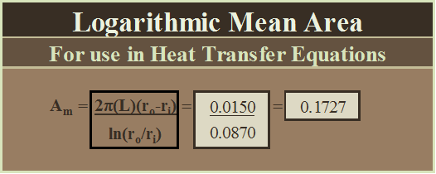
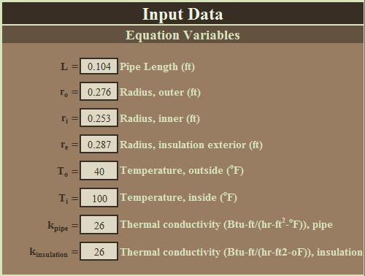
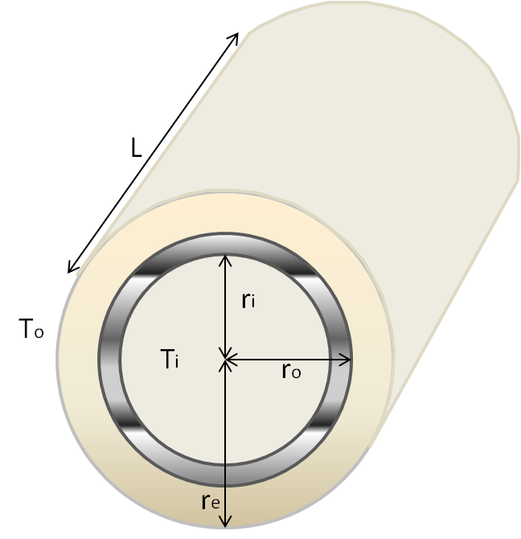
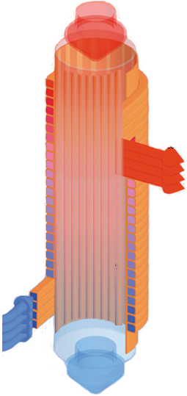
Building Summary
Objectives
Mechanical Investigation
Electrical Investigation
Overall Evaluation
Conclusion
  Mechanical Space
  Domestic Water Reheat
  Electricity Production, Plant vs. Site
  Domestic Water Reheat
  Inputs

Slide 26
  Results
Building Summary
Objectives
Mechanical Investigation
Electrical Investigation
Overall Evaluation
Conclusion
  Mechanical Space
  Domestic Water Reheat
  Electricity Production, Plant vs. Site
Suggestions
Change condensate pipe to copper
Increase length of apparatus
Duplicate apparatus for existing building sanitary line
8.088 MBh heat recovered
358.87 MBh required
2.3% savings

Slide 27
Building Summary
Objectives
Mechanical Investigation
Electrical Investigation
Overall Evaluation
Conclusion
  Mechanical Space
  Domestic Water Reheat
  Electricity Production, Plant vs. Site
  1.2 MW Electricity, Plant
  1.2 MW Electricity, Site
Electricity, Consumed
Electricity, Produced
Total
Total
16,511,351 lbs. CO₂ | 11,909 lbs. SO₂ | 26,879 lbs. NO
20,905,565 lbs. CO₂ | 1,842 lbs. SO₂ | 31,312 lbs. NO
21% increase CO₂ | 84% decrease lbs. SO₂ | 14% decrease NO

